Slide 1
Design Of Radial Feed For Gear Hobbing Machine
Presented By:
Prajwal Nayak : Roll No. 50
Abhijeet Mandavgane : Roll No. 42
Susmit Nichat : Roll No. 51
Pawan Kulkarni : Roll No. 39
Project Guide : Mrs Bhavana M.M.
Sponsorship Credits: ARK MAKTEK PVT. LTD., CHAKAN.

Slide 2
Hobbing machine
Hobbing is a machining process for gear cutting, cutting splines, and cutting sprockets on a hobbing machine, which is a special type of milling machine.
Uses a hobbing machine with two skew spindles, one mounted with a blank work piece and the other with the hob.
The hob is a cutting tool used to cut the teeth into the workpiece.

Slide 3
Scope of project
Design of mechanism used in hobbing machine: We Are designing the radial feed of a CNC gear Hobbing Machine. The Feed Is Driven By a recirculating ball screw.
The Main Advantage Of ball screw over lead screw is that it eliminates backlash error which is not the case with lead screw.
The various design steps performed to manufacture Gear Hobbing Machine are Also Covered.

Slide 4
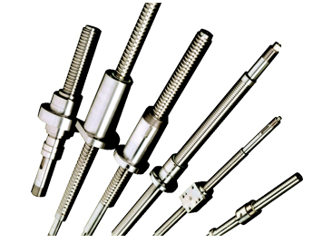
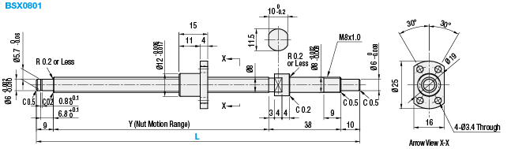
Schematic Of Ball Screw

Slide 5
Reasons for Using Ball Screw
Higher Efficiency
Lesser Heat Generation
No Stick-slip
Higher Service Life
High Precision & Rellability
Precise Positioning
High Power Transmission

Slide 6
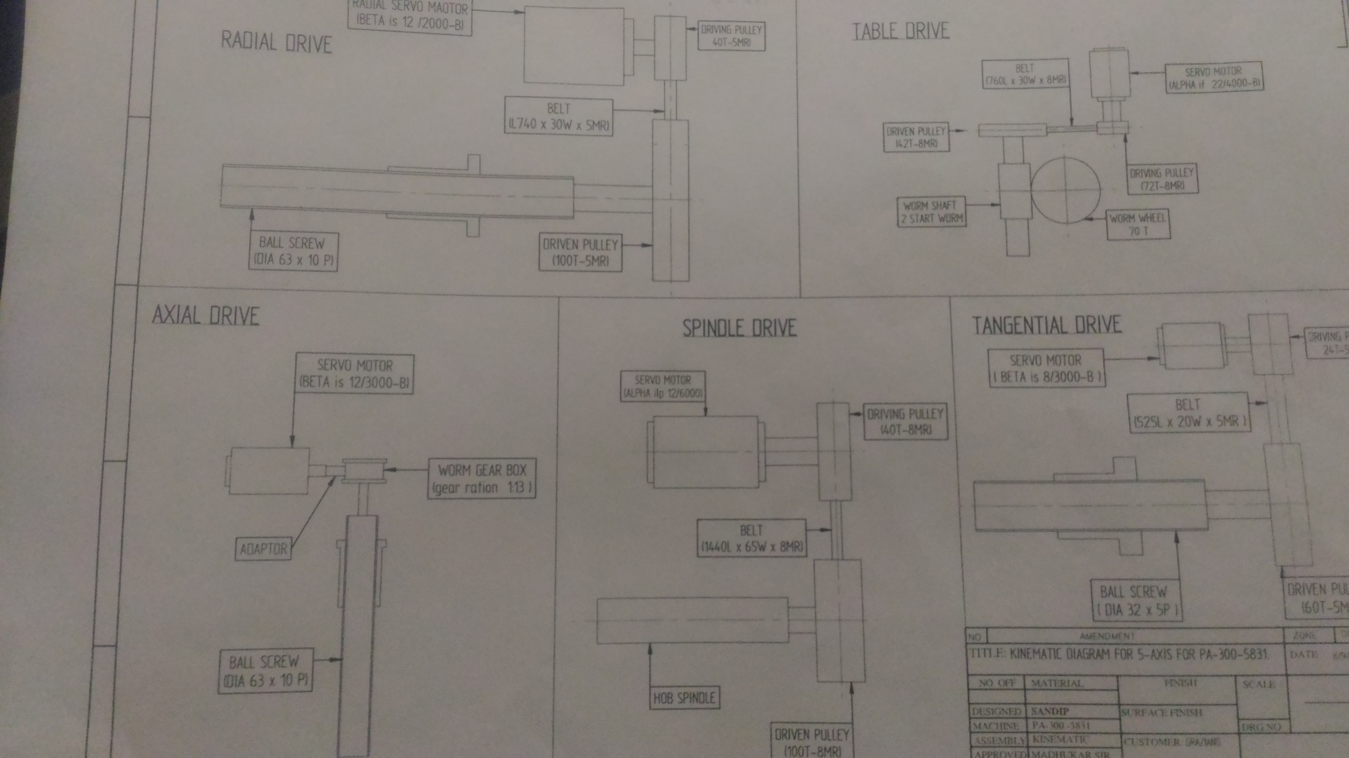
Kinematics Of Gear hobbing Machine

Slide 7
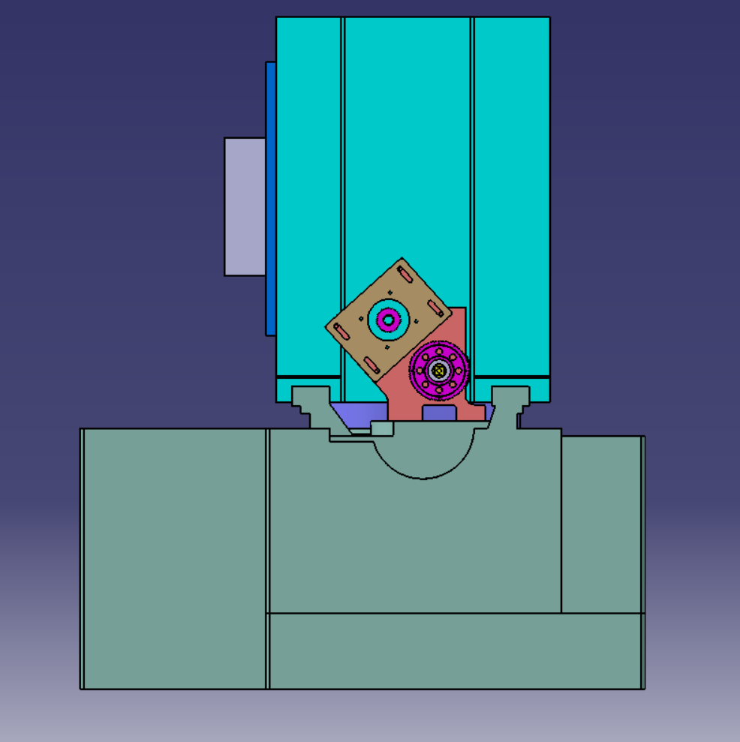
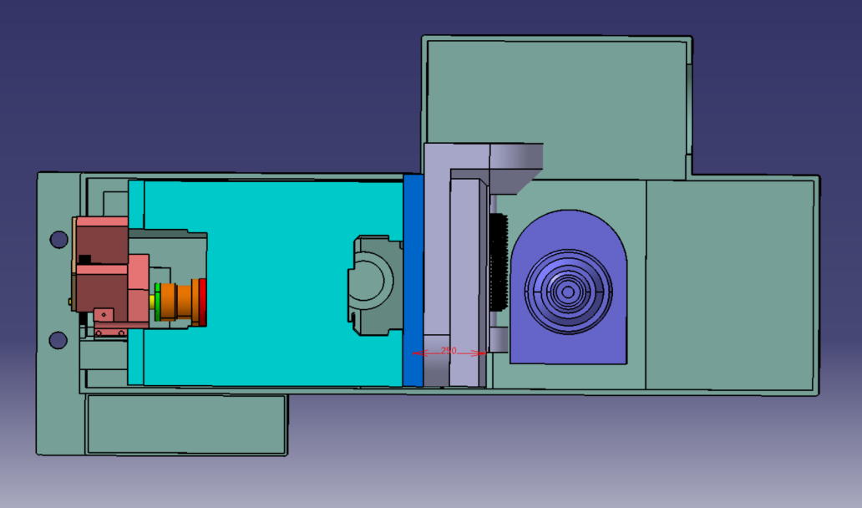
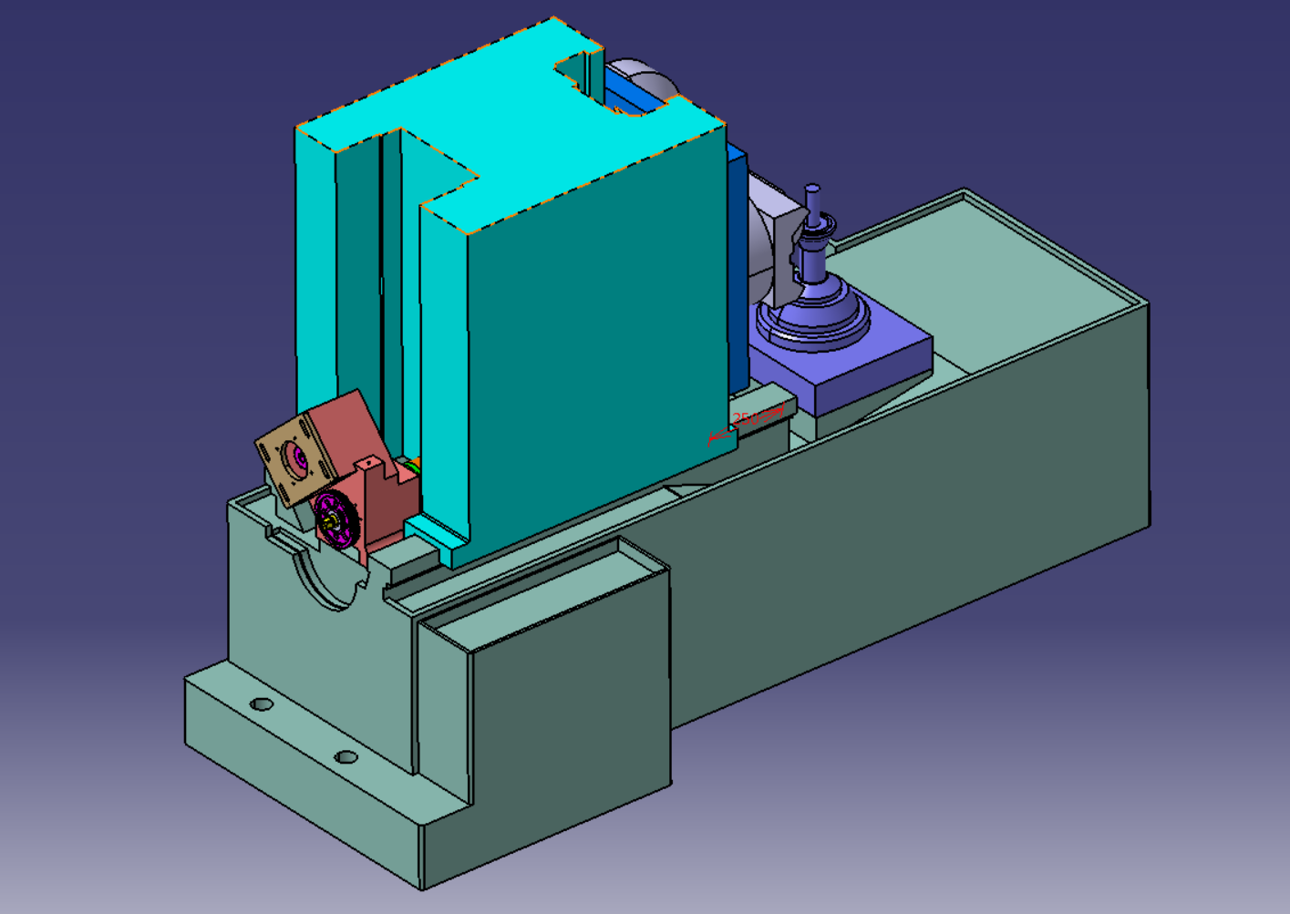
Model Of PA320 In CATIA V5R20

Slide 8
Steps In Design Of Hobbing Machine
Selection Of Shaft And Nut: Based on The Given Parameters suitable calculations for the length and diameter of shaft are made.
Validation Of Selected Bearing: The Manufacturer Has recommended a certain type of bearing. Using The Basic Calculations, Validity and Suitability Of the Bearing Is Confirmed.
Design Of Bearing Housing: Based On The obtained Bearing , a Suitable Type Of Bearing housing is designed

Slide 9
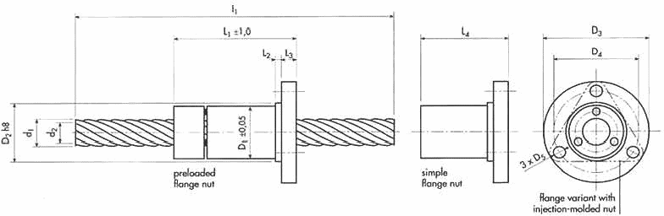
Selection Of Screw Shaft
The Following Calculations Were Made For Selection Of Screw Shaft
Maximum stroke of column : 270 mm
Minimum stroke of column : 30 mm
Total effective stroke of the column: 270 – 30 = 240 mm
Nut length : 161 + 19 = 180 mm
Clearance distance = 10 mm
Total length of Ball screw = 240 + 180 + 10 = 430 mm
Take total Safe length = 440 mm

Slide 10
Validation Of Selected Bearing
In Order To Obtain A Bearing For Our assembly, we Performed A Market research and obtained information about IBC and Temkin Bearing
Hence, We Compared BS40M72 And BS40M90 Bearing.
We Performed Various Calculations And Validations And Finally Selected The BS40M90 Type Of Bearing.
INNER DIAMETER (d) = 40 mm
OUTER DIAMETER(D) = 90 mm
Basic dynamic load capacity(C) = 59000 N
C_{r}= 58155.46 N
L₁₀ = 1500 Million Revolution .
HERE C>C_{r.} THUS THE BEARING SELECTED IS SUITABLE.

Slide 11
Design Of Bearing Housing
We had to restrict our design thinking and modeling due to the assigned area for bearing house mount.
On the basis of this area we started our design iterations.
Basic background check for the housing is that we need to convert the rotary motion of the shaft to linear motion.
Along with this we need to hold the shaft so as it does not move along with the column giving rise to any back lash error.
We inserted three BS40M90 bearings within the housing to hold the shaft .

Slide 12
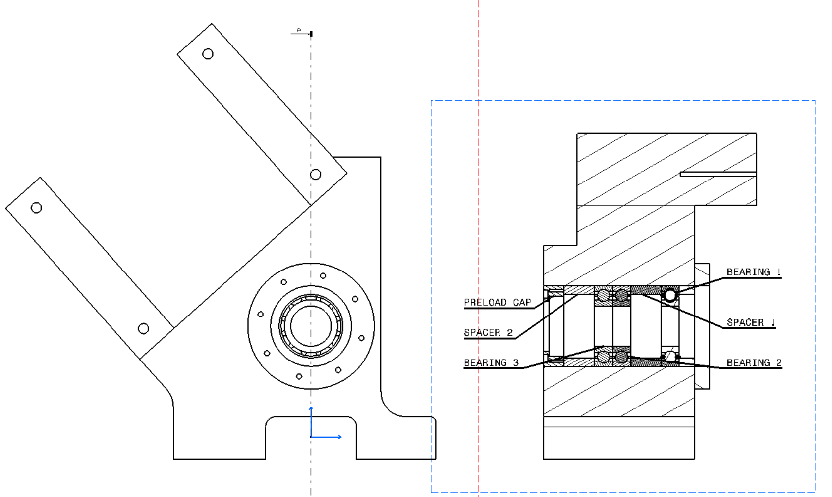
DRAFT OF DESIGNED BEARING HOUSING

Slide 13
Machining Processes
We used EN36 For Bearing Housing model.
Later we Got It Machined From the Dealer.
We Got Our Shaft Designed As Per Our Calculations And Design Conditions From Dealer

Slide 14
Machining Processes Used
Scrapping:
The guide ways was applied with a certain amount of glue and was then scrapped out with the help of a chisel. These processes helped in filling up minute gaps present over the surface and provide a flat surface. This same procedure was carried out over the column strip.
Lapping:
Lapping is a machining process in which two surfaces are rubbed together with an abrasive between them, by hand movement or using a machine. This can take two forms. The lap is then used to cut a harder material the work piece.

Slide 15
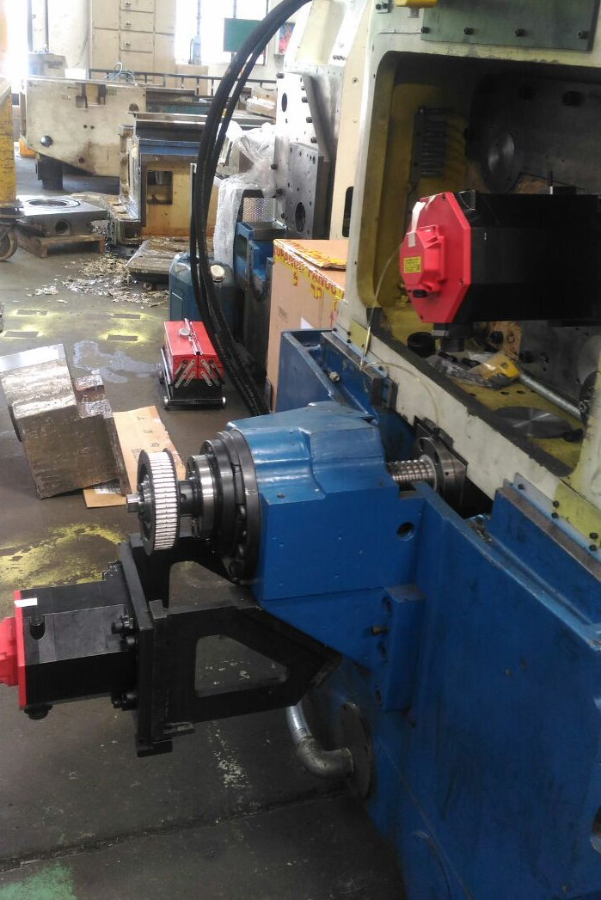
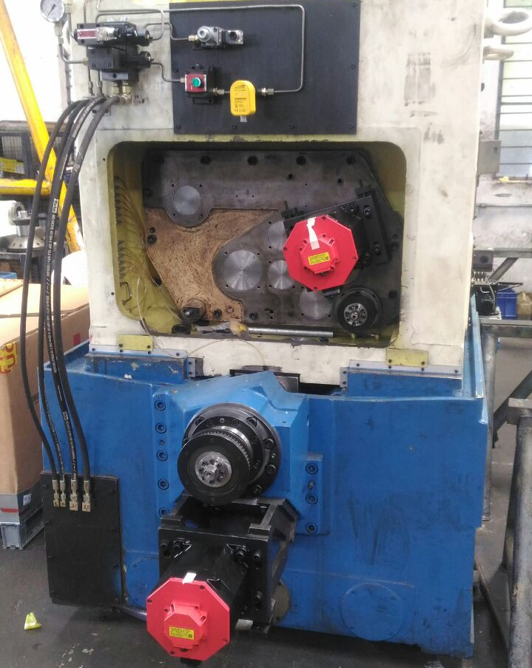
Schematic of hobbing machine

Slide 16
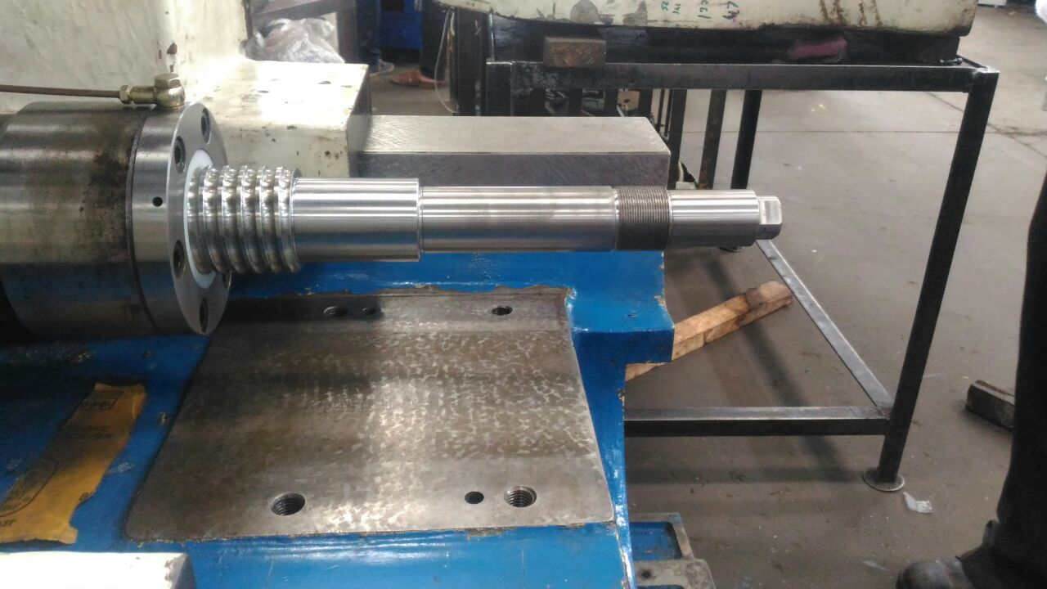
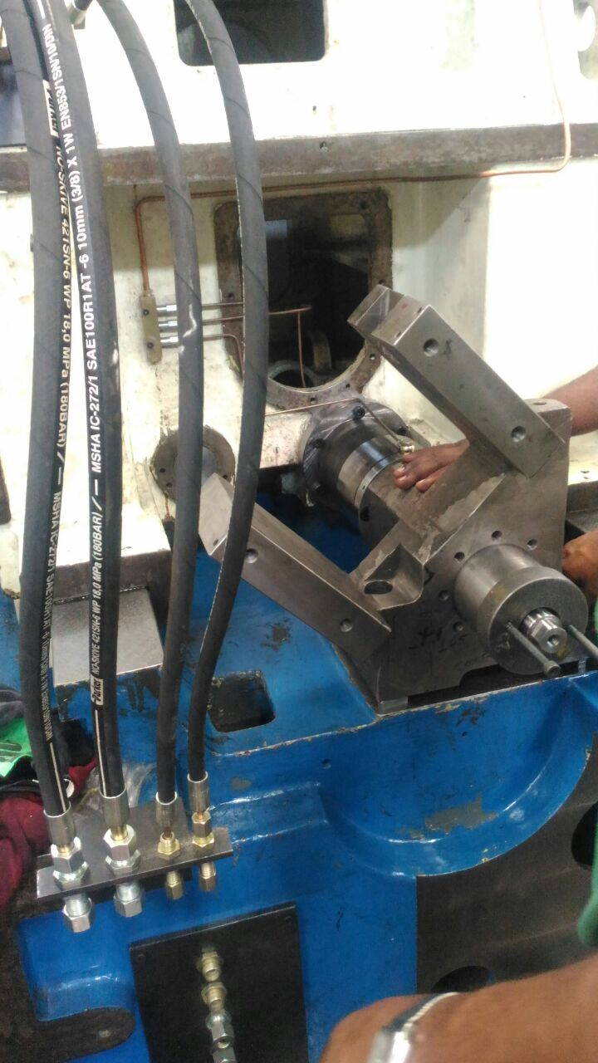
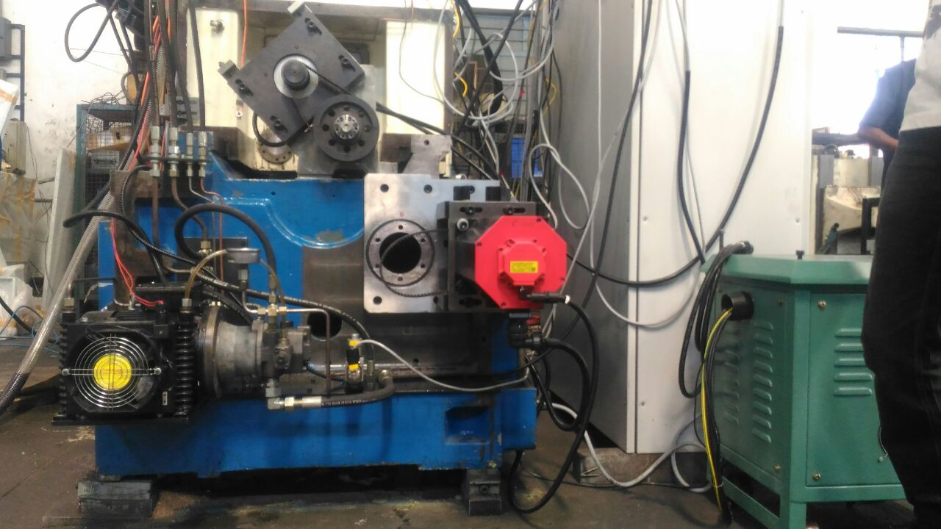
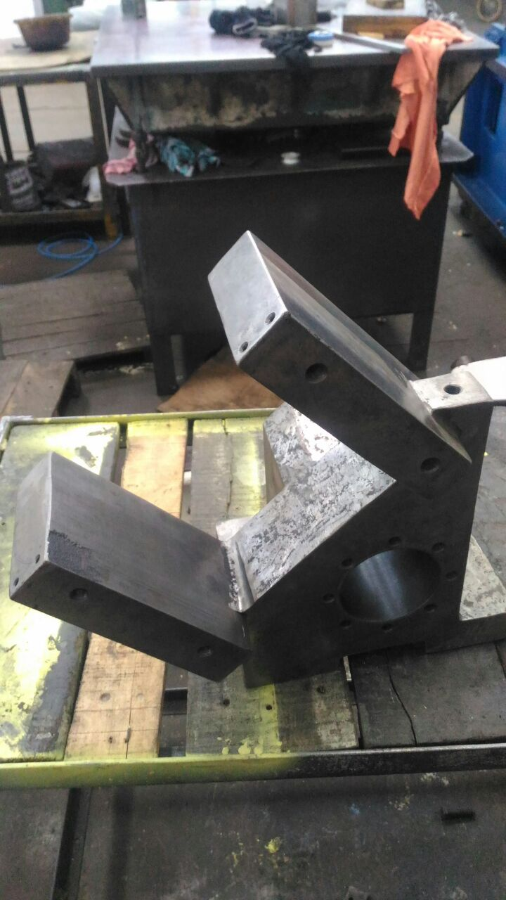
ACTUAL BALL SCREW USED
BEARING HOUSING ASSEMBLY
REAR VIEW OF RADIAL FEED
BEARING HOUSING CASING

Slide 17
COST ESTIMATION
THE ABOVE COST IS APPROXIMATE . The Actual Cost May Vary!
The Entire Project Amount Is Sponsored By ARC MACHTECH PVT. LTD
SR. NO. | Particulars | Cost
1 | Material | 1,00,000
2 | Machining | 15,000(approx.)
3 | Labour | 20,000
4 | Finishing & Testing | 15,000
5 | Coding Unit | 1,00,000
 | TOTAL COST | 2,50,000 (approx.)

Slide 18
CONCLUSION
Thus, our design project has covered the complete design and modelling of the radial feed of a CNC Gear Gear Hobbing Machine.
We also covered the various machining processes carried out during the conversion of a simple gear hobbing machine into a CNC Gear Hobbing Machine.
The Various Design Validation And Calculations carried out by us match with the design specifications of the company.

Slide 19
THANKYOU!

